Slide 1
Electronics Laboratory Project
Face Recognizable and Things Detectable Drone Controller With Neo-7 GPS Module

Slide 2
Objective:
We will build up a drone that will be used to find people in a certain area. Along that, it will also send real time location to distant controller. Here, we are using ESP32 camera for face recognition system. In bad weather or in famines it might not be possible for a person to find his/her neighbors or parents or children by physically going into that place. Our face recognition system will have pre assigned data of that desired persons whom we want to find out. Even we can use face recognition system along with drone which will be helpful to find out lost children in a particular area too.

Slide 3
Project Components:
Arduino Pro Mini
Esp32 cam
FTDI programming board
Bluetooth Module
Neo-7 GPS Module
Arduino Uno
Jumper wires

Slide 4
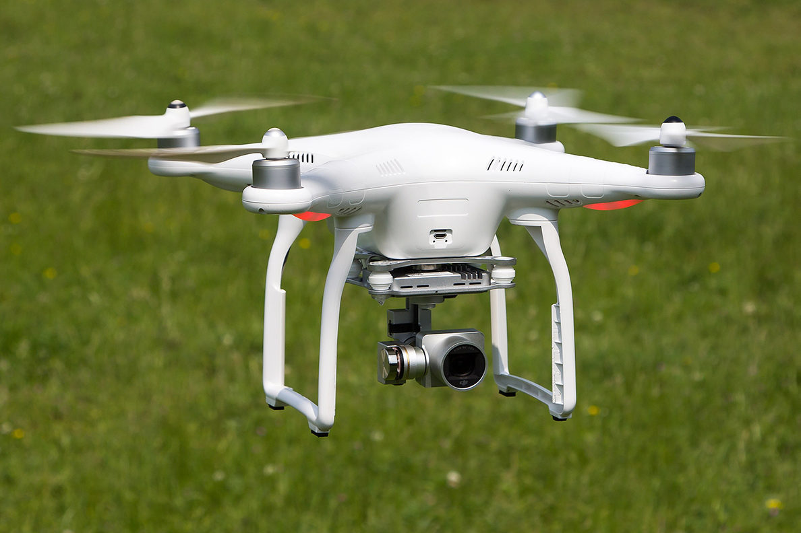
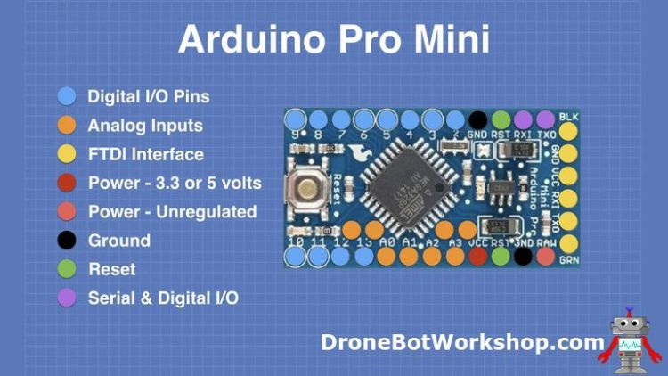
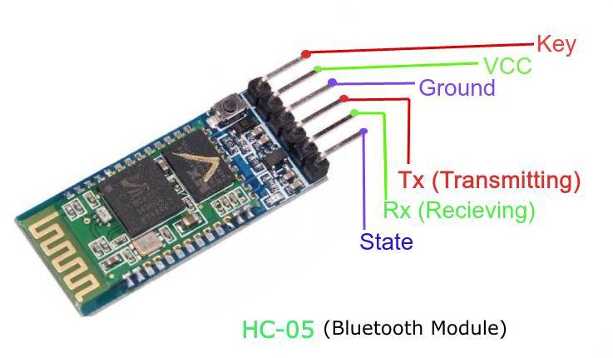
Arduino Pro Mini:
Bluetooth Module:

Slide 5
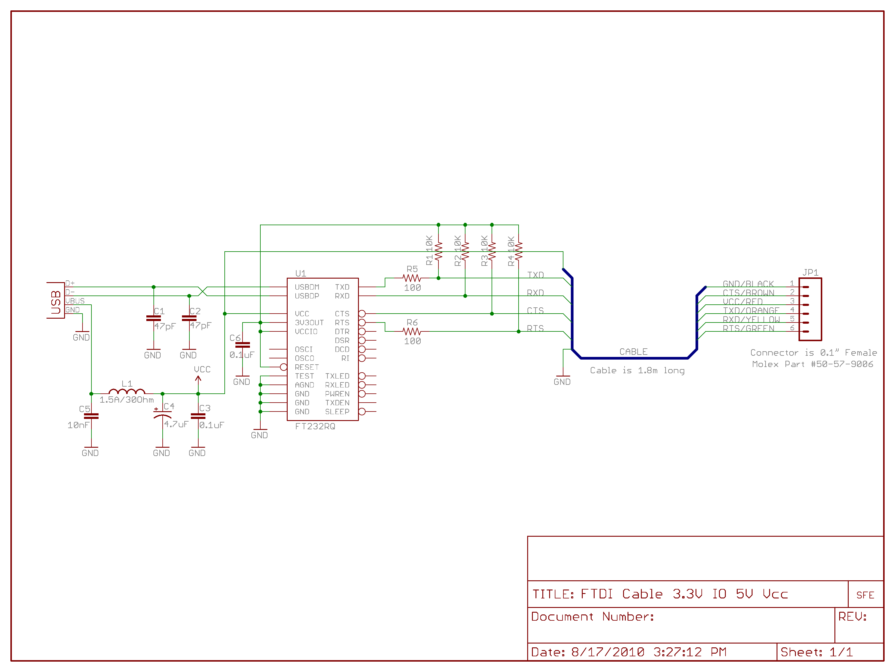
FTDI Programming Board:

Slide 6
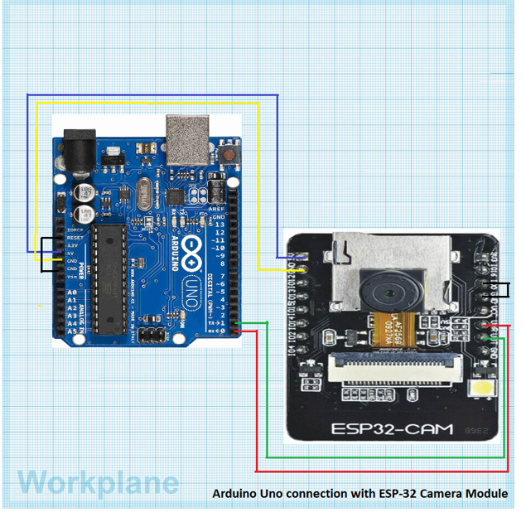
Project Description:
First we will set up Arduino Uno with a computer. We need to upload basic operating codes to make the Arduino workable. After that we will connect our ESP32-Cam with this by following the circuit diagram.
Able to detect Temperature Also

Slide 7
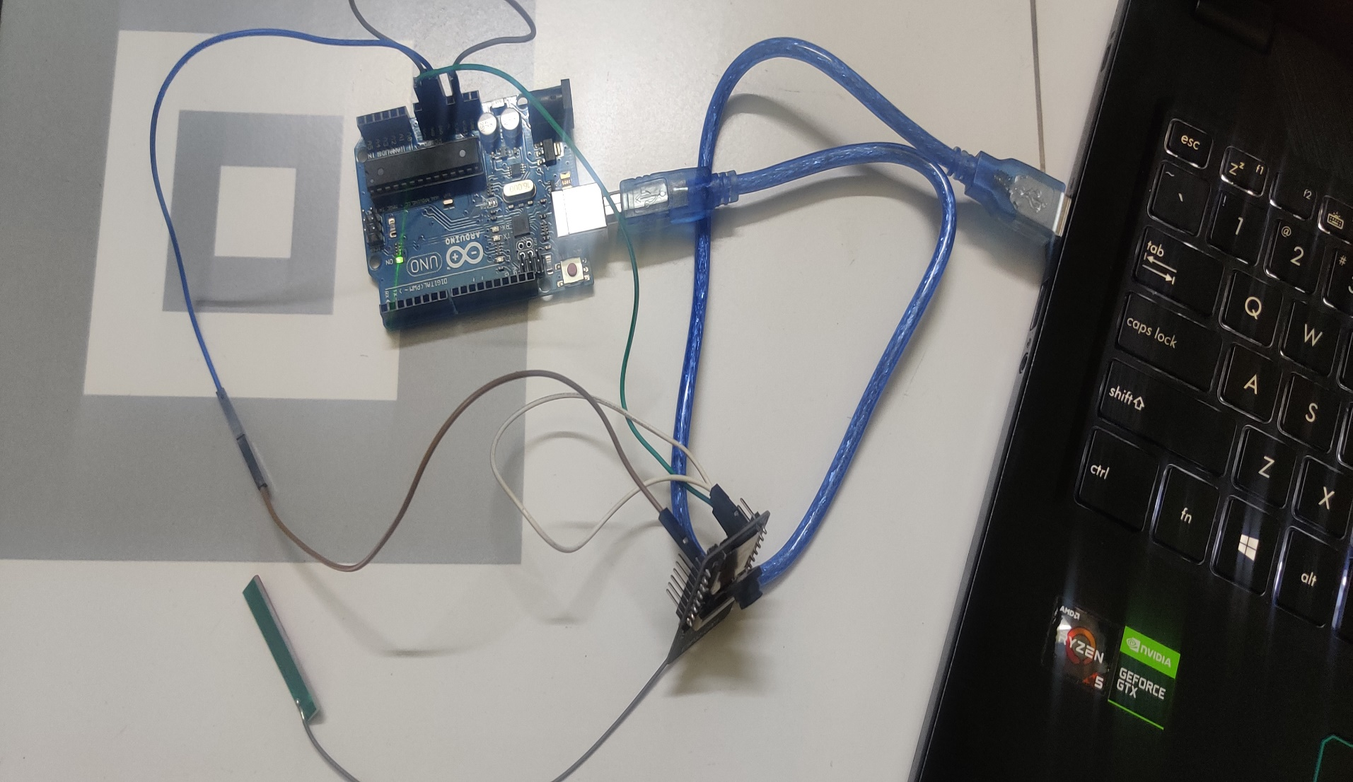
We Will Connect Arduino Uno With ESP32 CAM LIKE THE Following This Circuit.

Slide 8
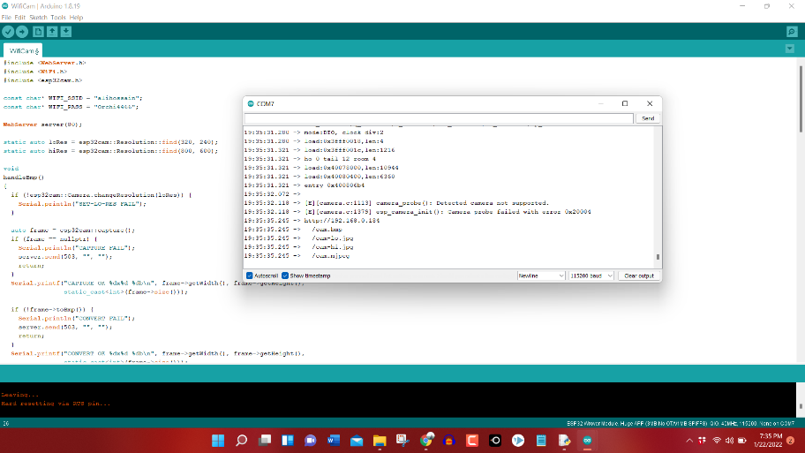
Uploading Codes:

Slide 9
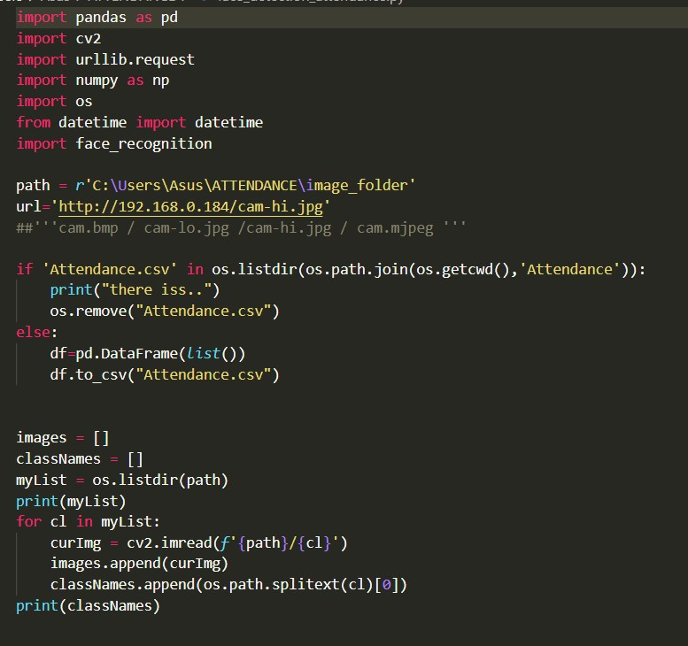
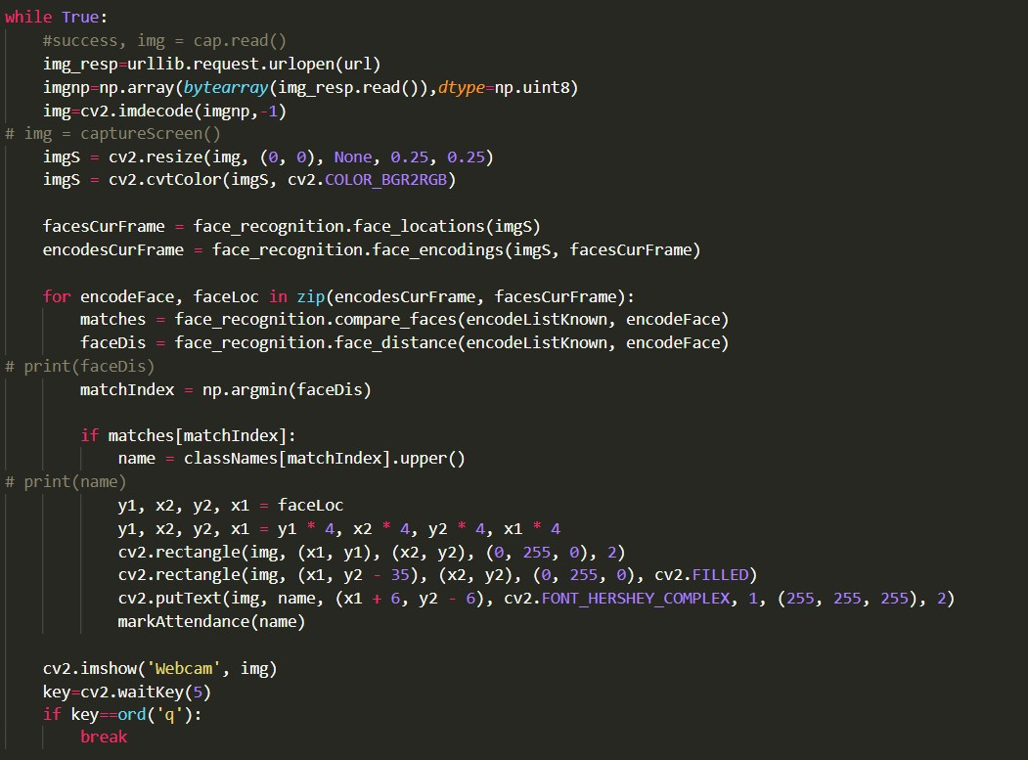

Slide 10
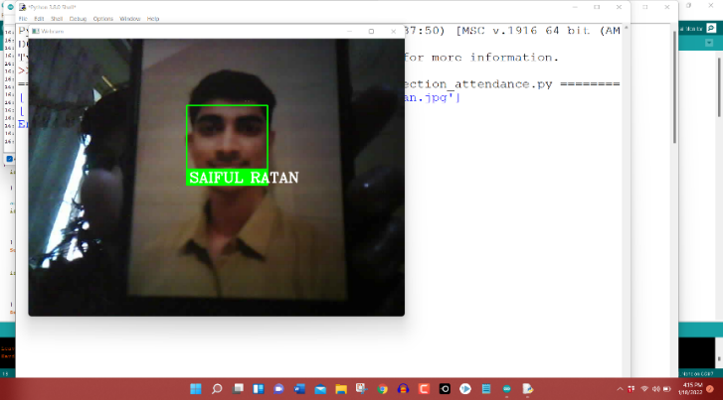
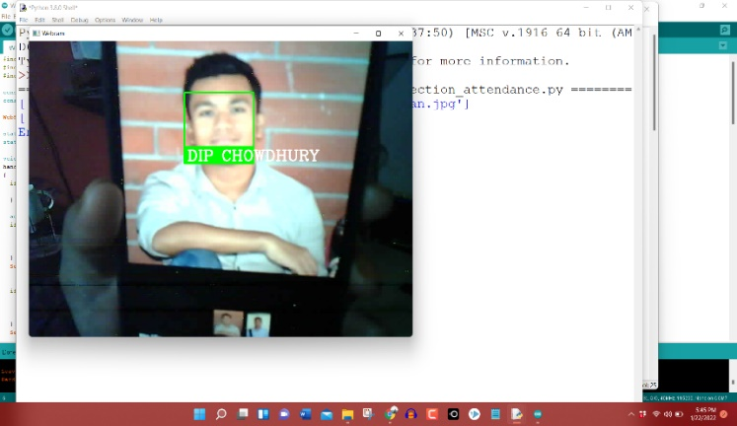
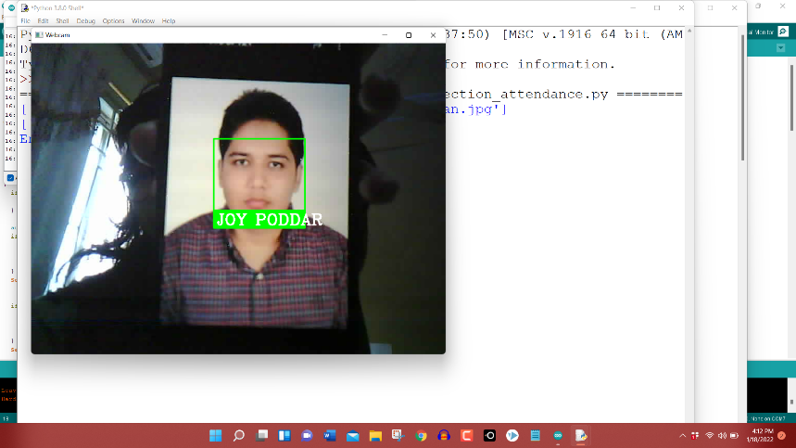
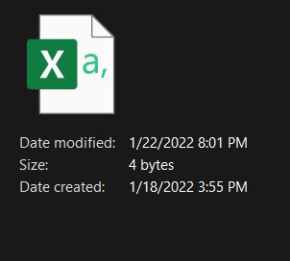
Results:

Slide 11
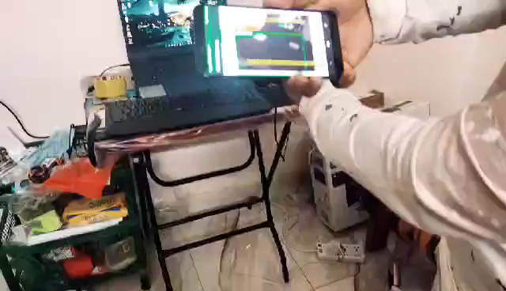
Object detection with ESP32 AI Thinker App

Slide 12
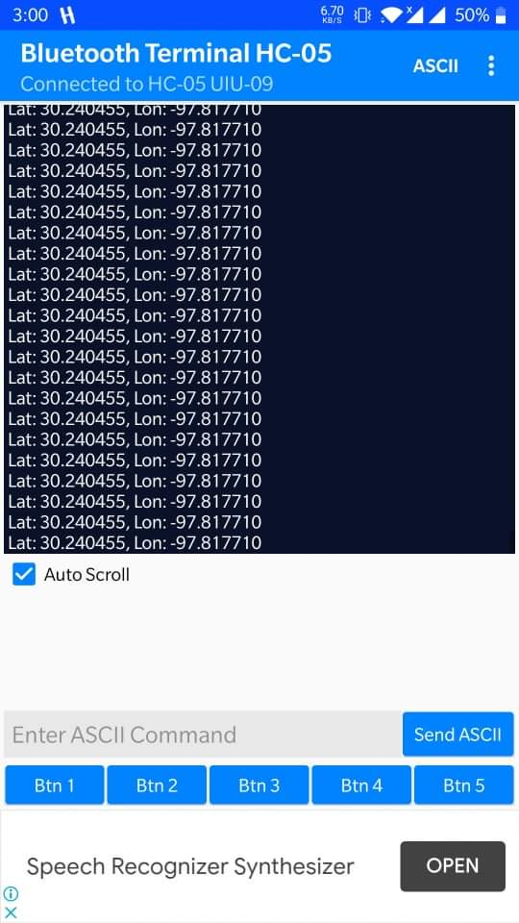
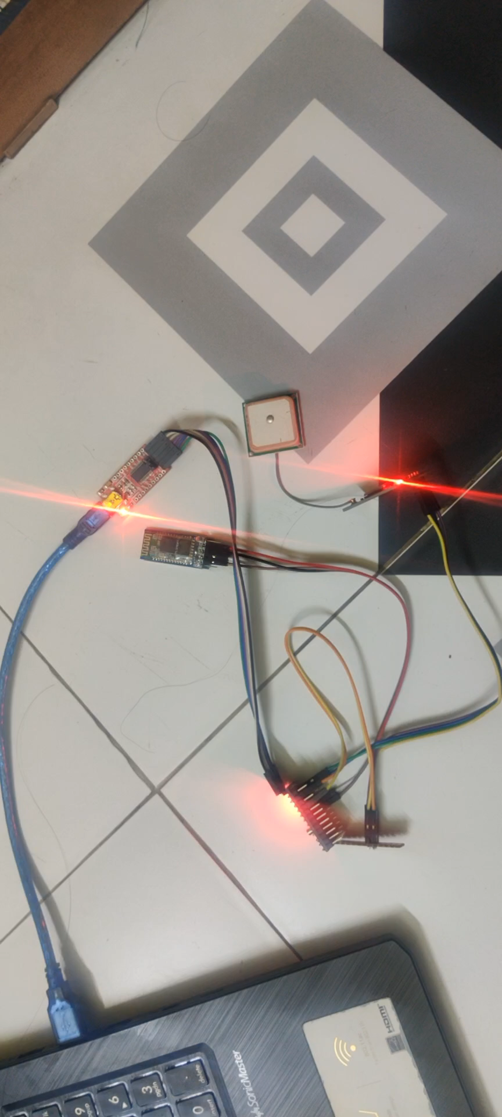
Location Detection
Bluetooth Terminal HC-05 App

Slide 13
Website to find latitude and longitude
http://maps.google.com/maps?q=39.211374,-82.978277+(My+Point)&z=14

Slide 14
A. Working Overview
Our ESP32-Camera module is connected with Arduino Uno. Now we have to uploaded the necessary codes to make them establishing working environment among them.
After setting up working environment, we need to upload specific codes for individual purpose. First we set up object identifying code and connecting it with ESP32 AI Thinker App. After connecting the ESP32 with the same WIFI we will be able to detect various objects.
We used a standard 4GB Micro SD Card in ESP32-Camera module to store data. We also gave some pre assigned face data there to identify person. When it comes about person identification, we will use face recognition system. ESP32 will compare peoples face with pre assigned data using OPEN CV. Our system will identify the person flawlessly among the people whose face data was stored in the system.
There will be an .xls file where detected persons list will be preserved along with time stamp.
Our WiFi-Bluetooth Module will help to send real time Latitude & Longitude value to

Slide 15
another server where we are using RC receiver . Latitude & Longitude data of that person will also be stored in the .xls file.
We have to copy that data of .xls file column. Now we will open a browser & go to the following link: http://maps.google.com/maps?q=39.211374,-82.978277+(My+Point)&z=14
We will paste that data in the box of this page.
Now this will show the real time location of that person.
Finally this device will send the location to a pre assigned number.

Slide 16
THANK YOU

